Slide 1
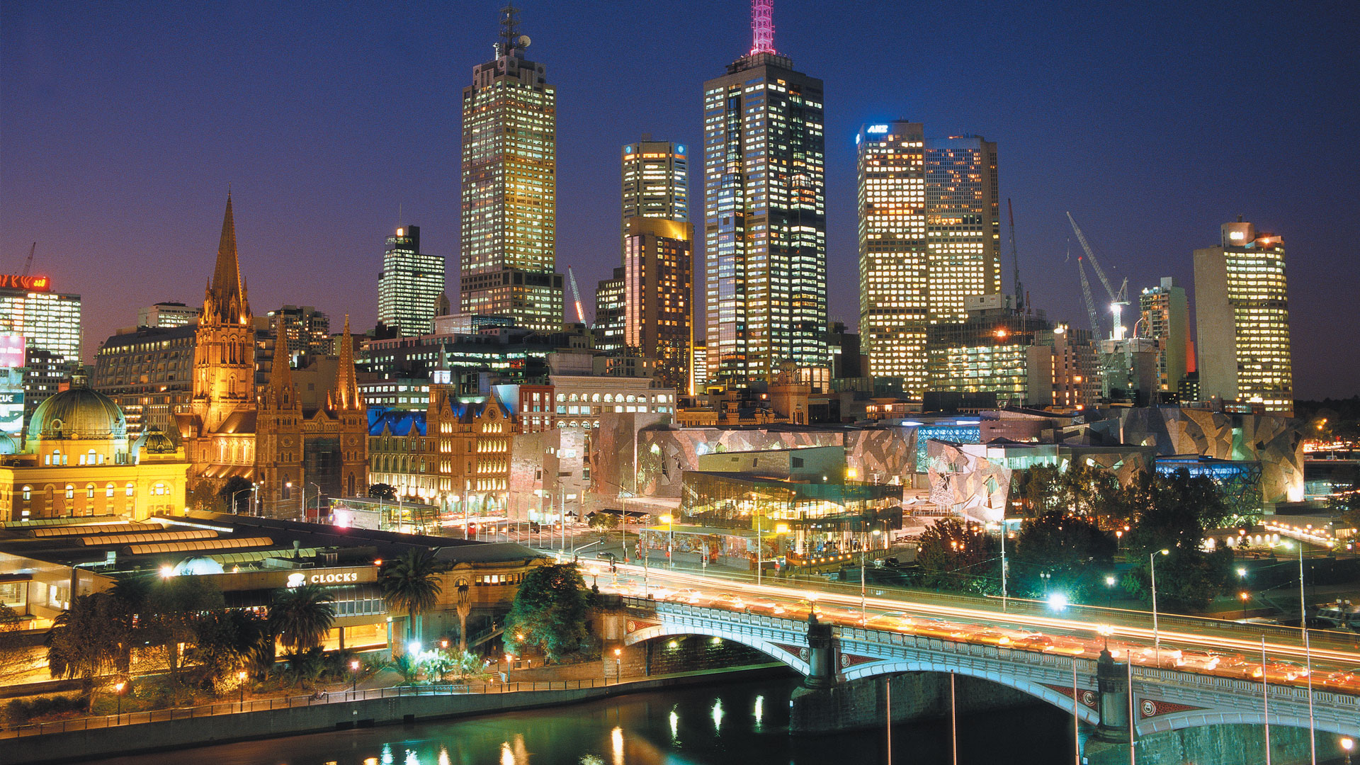
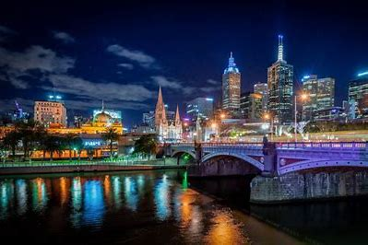
Crime in Victoria
Latest CRIME STATISTICS

Slide 2

What type of Offences?
CRIMINAL INCIDENTS
Over the LAST Ten Years

Slide 3
WHAT IS CRIMINAL INCIDENTS?
A recorded criminal incident is a criminal event that may include one or more offences, alleged offenders and/or victims, and that is recorded on a single date and at one location.
The criminal incident count is designed to represent the broad event that occurs as a more representative measure of instances of crime, rather than using the bulk number of offences that Victoria Police members record within one incident.
Consequently, there's could be many offences in one criminal incident.

Slide 4
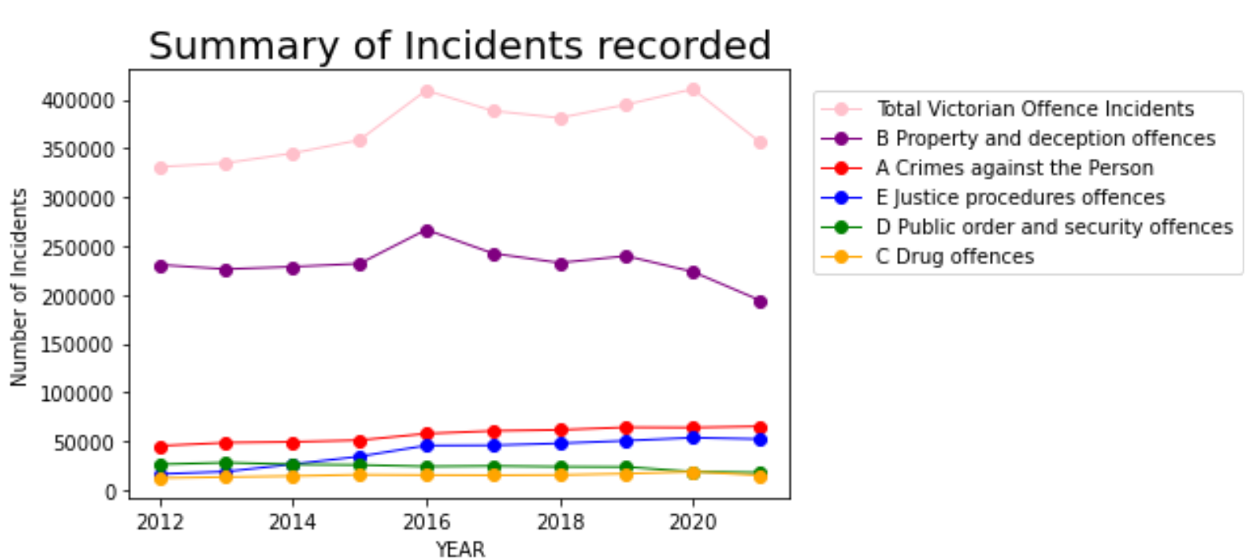
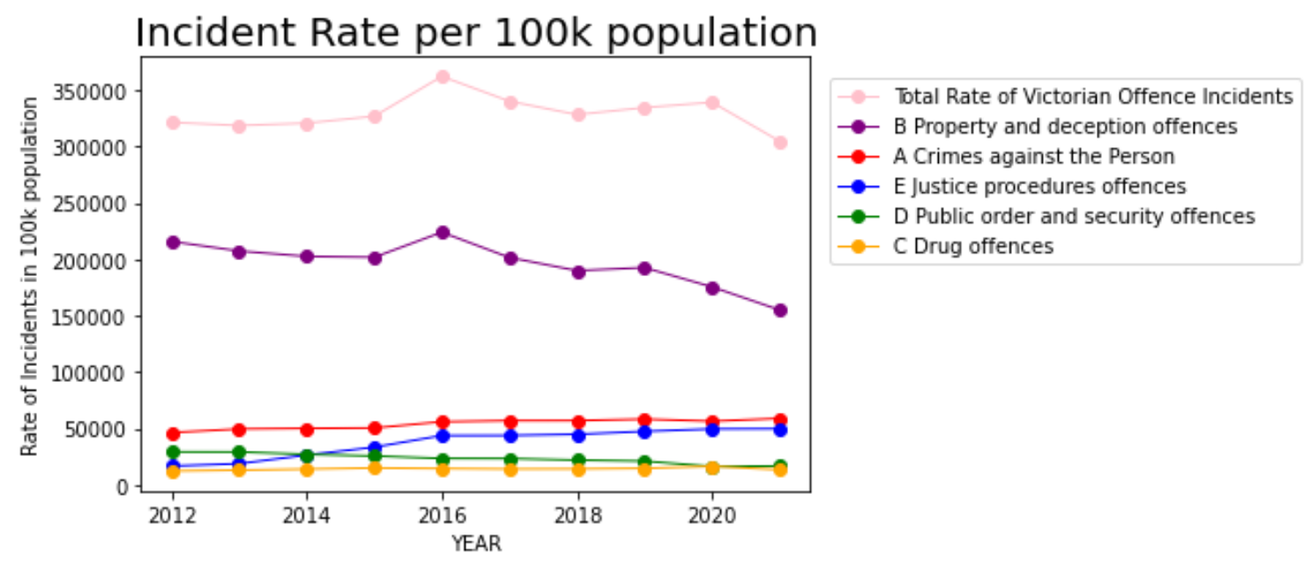
Note:
Property and deception offences (Purple line) have far exceeded other Victorian offences.
The peak in 2016 relates to “Theft” as we will discover in the next slide.
The significant drop in Crime in 2020 is mostly due to COVID lockdowns in Victoria.

Slide 5
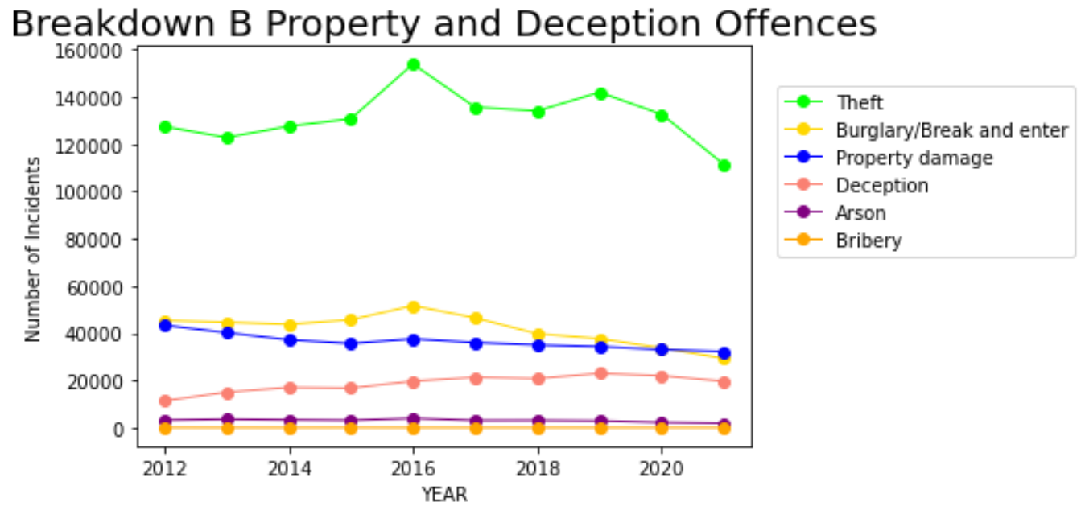
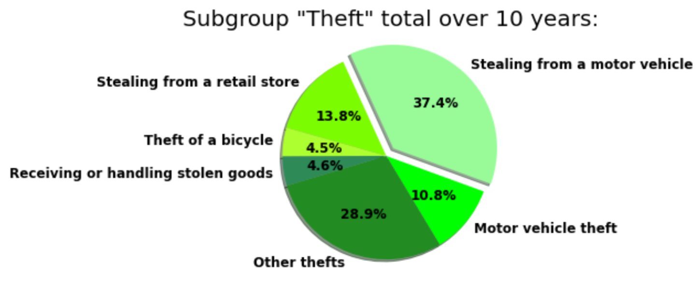
Note:
The peak in 2016 is mostly caused by “Theft”.
The Covid lockdowns in 2020-2021 resulted in significantly less thefts but other crimes remained relatively stable.

Slide 6
What about the other more serious Offences?
CRIMINAL INCIDENTS
Over the LAST Ten Years

Slide 7
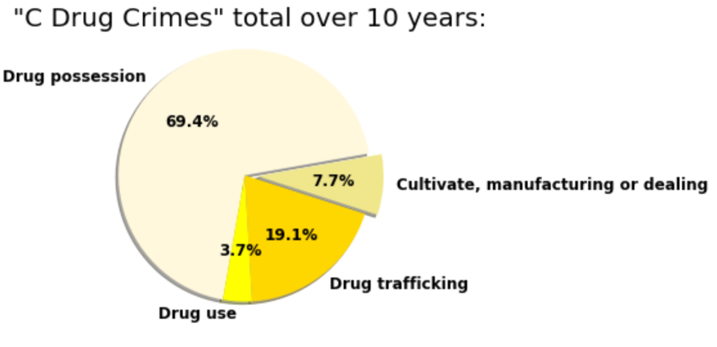
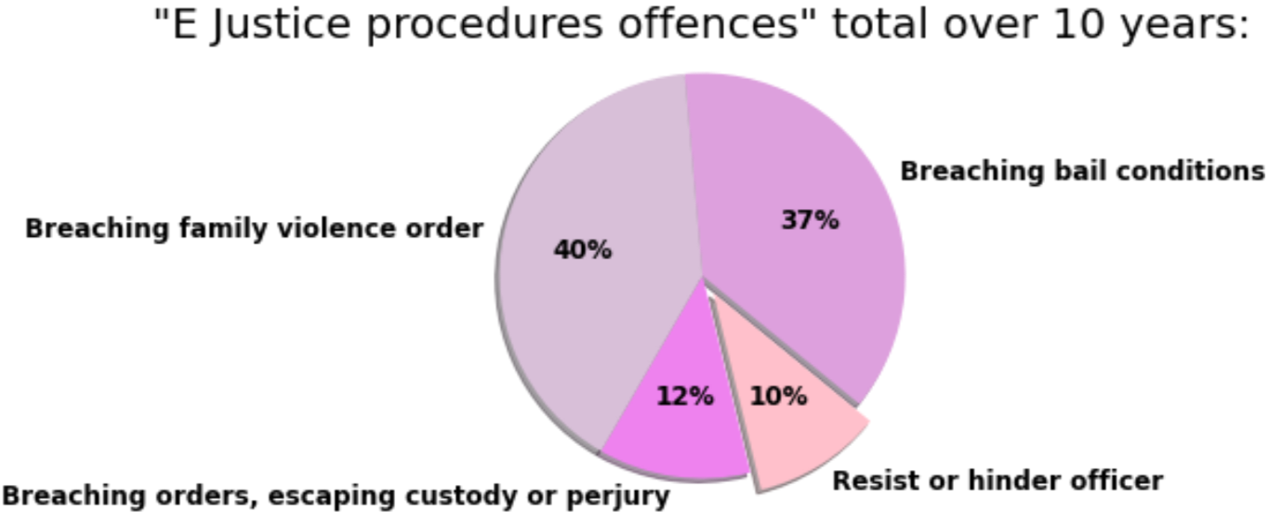
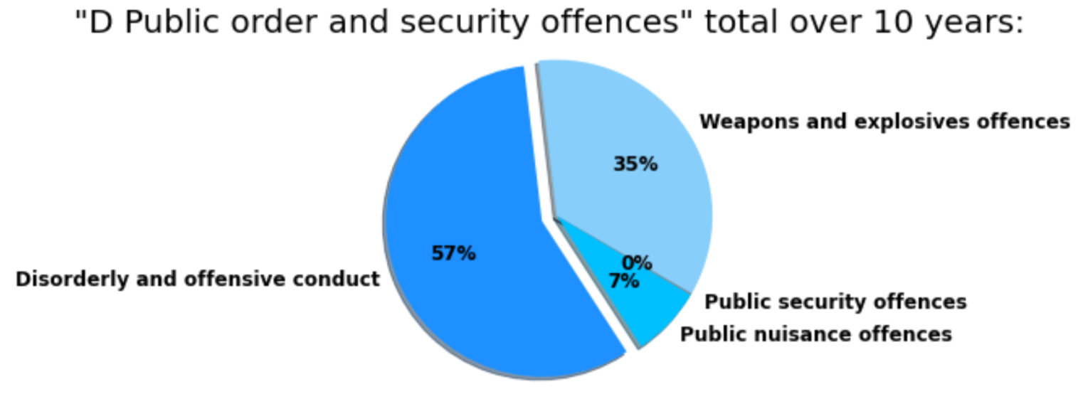
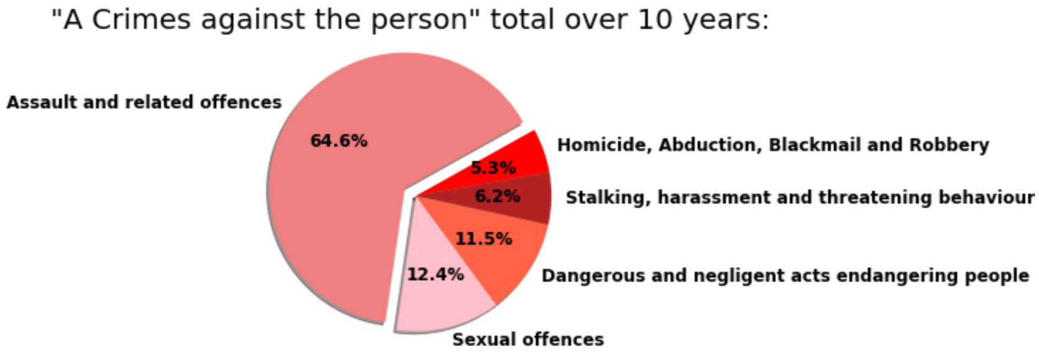

Slide 8
Where do these Offences occur?
CRIMINAL INCIDENTS
Over the LAST Ten Years

Slide 9
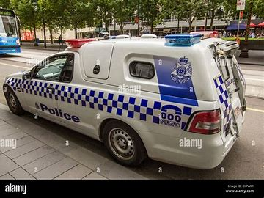
WHAT IS LOCAL GOVERNMENT AREA?
Local government areas (LGAs) in Victoria, sorted by POLICE region.
LGA’s are also referred to as municipalities, the 79 Victorian LGAs are classified as cities (34), shires (38), rural cities (6) and boroughs (1). In general, an urban or suburban LGA is called a city and is governed by a City Council, while a rural LGA covering a larger rural area is usually called a shire and is governed by a Shire Council.
Local councils have the same administrative functions and similar political structures, regardless of their classification.
The sorting of LGAs into POLICE regions is for presentation purposes only, and has no legal or administrative significance.

Slide 10
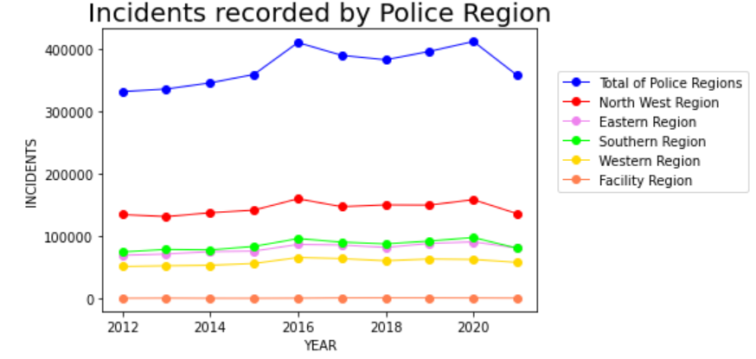
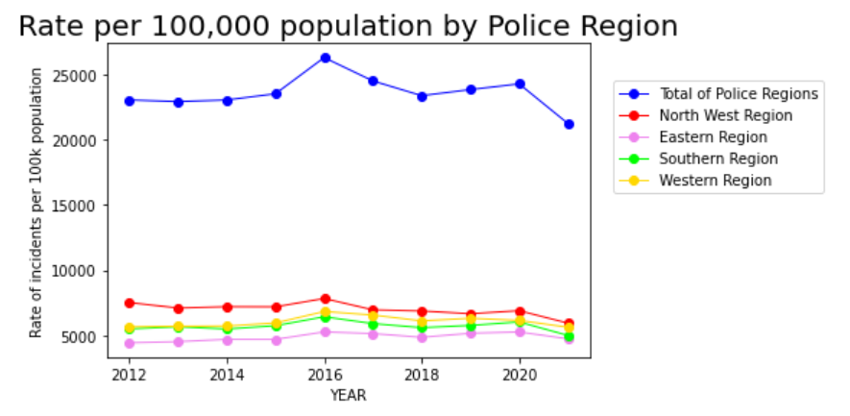
Note:
The Victoria Police Region breakdown shows most crimes are occurring in the North West Region
In the following slide we will investigate the LGA ‘s of the North West Region.

Slide 11
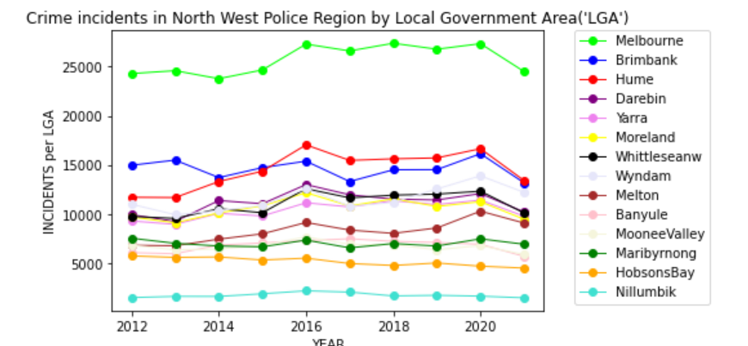
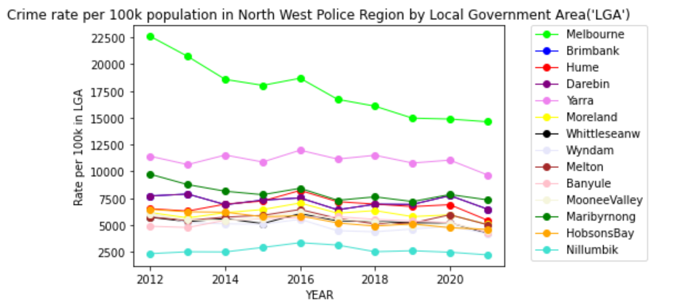
Note:
In the North West Police Region most crimes are occurring in Melbourne LGA.
The rate per 100,000 population shows a decrease for Melbourne LGA since 2016.
This is possibly because of increased policing and higher population density in the city.

